Slide 1
Twitter Sentimental Analysis
Nisha Pepsi Selvarajan

Slide 2
Sentiment Classification Problem
Sentiment classification is the task of looking at a piece of text and telling if someone likes or dislikes the thing they’re talking about.
The input X is a piece of text and the output Y is the sentiment which we want to predict.

Slide 3
Architecture
Tweets
Data Clean
Embedding
Deep Network
Fully Connected Network
RELU
Output Layer
Softmax/Gradient Descent
Sentiment

Slide 4
Word Embedding
Word Embedding is a representation of text where words that have the same meaning have a similar representation. In other words it represents words in a coordinate system where related words, based on a corpus of relationships, are placed closer together.
lookup table to map the words represented by numeric indexes to their dense vector representations.

Slide 5
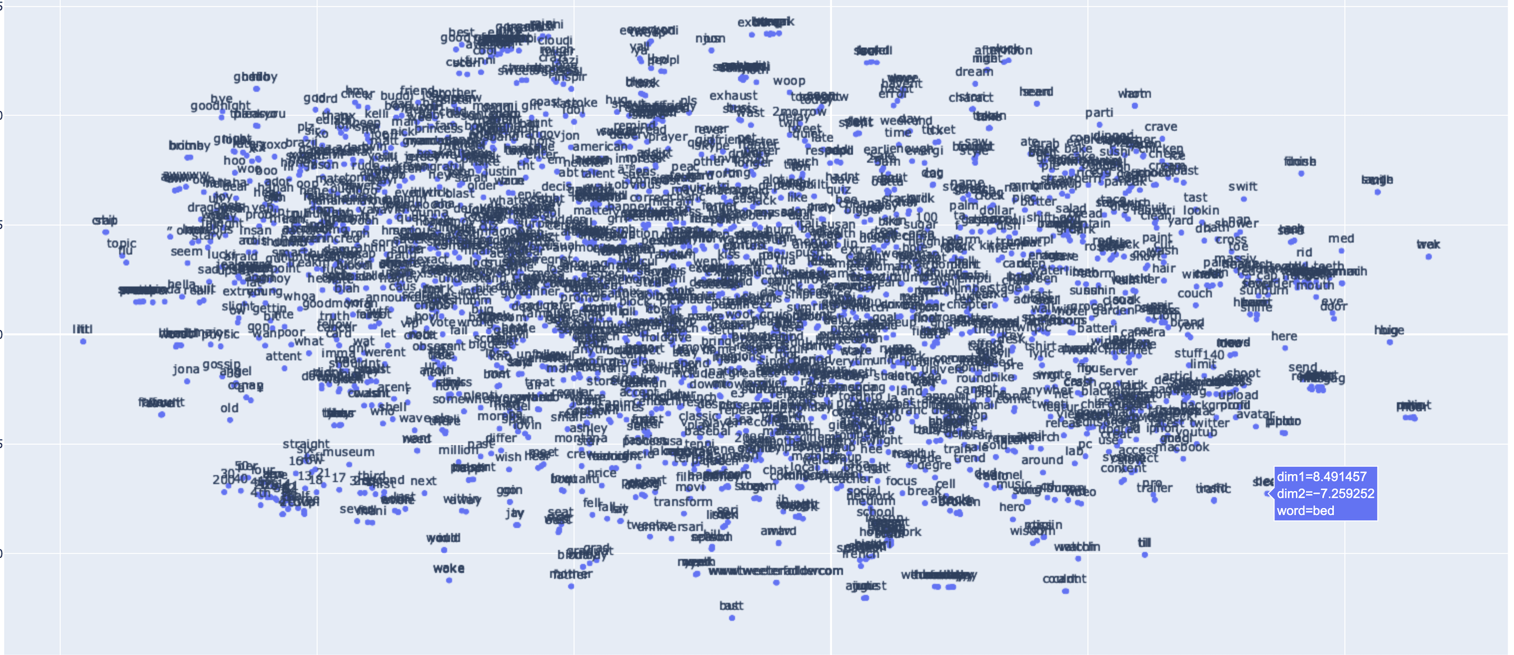
Word Embedding

Slide 6
Deep Network/Fully Connected Layer
Deep network takes the sequence of embedding vectors as input and converts them to a compressed representation. The compressed representation effectively captures all the information in the sequence of words in the text. The deep network part is an RNN.

Slide 7
Deep Network/Fully Connected Layer
Deep network takes the sequence of embedding vectors as input and converts them to a compressed representation. The compressed representation effectively captures all the information in the sequence of words in the text. The deep network part is an RNN.
Hyper parameters: RNN Hidden Layer size/ batch_size / epochs/learning rate(AdamOptimizer)

Slide 8
Architecture
Layer sizes: embedding layer, number RNN cells, hidden layer

Slide 9
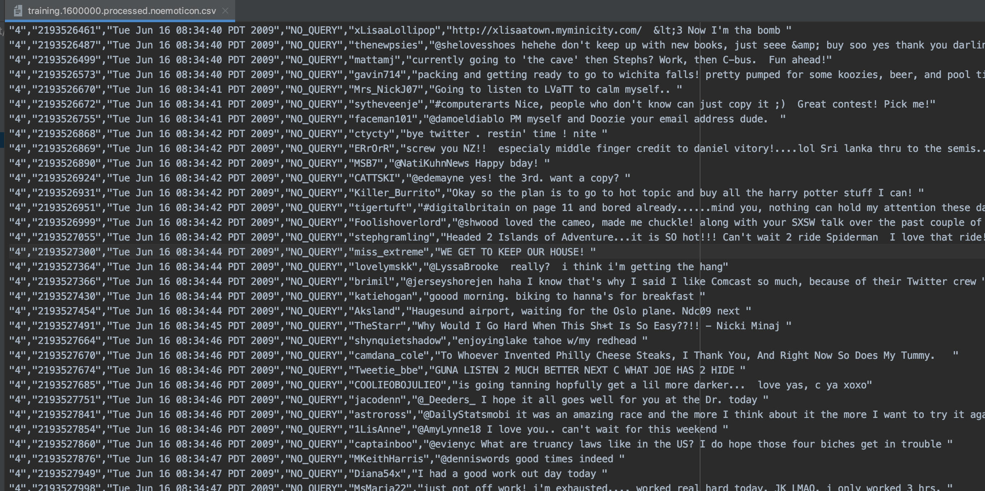
Input Tweets
DataSet: http://help.sentiment140.com/.:0 - the polarity of the tweet (0 = negative, 2 , neutral, 4 = positive) 2 million

Slide 10
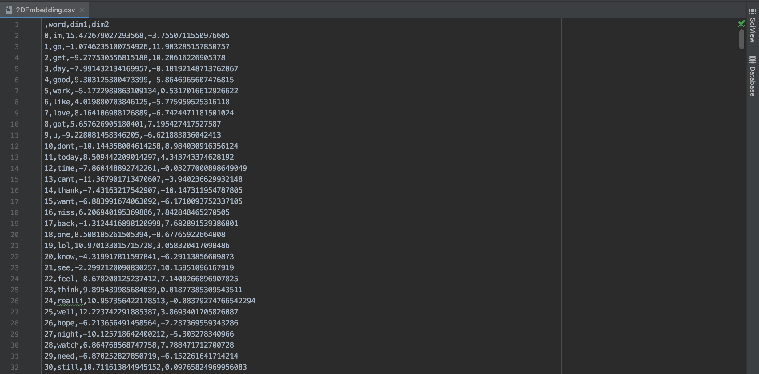
Word With Dimension

Slide 11
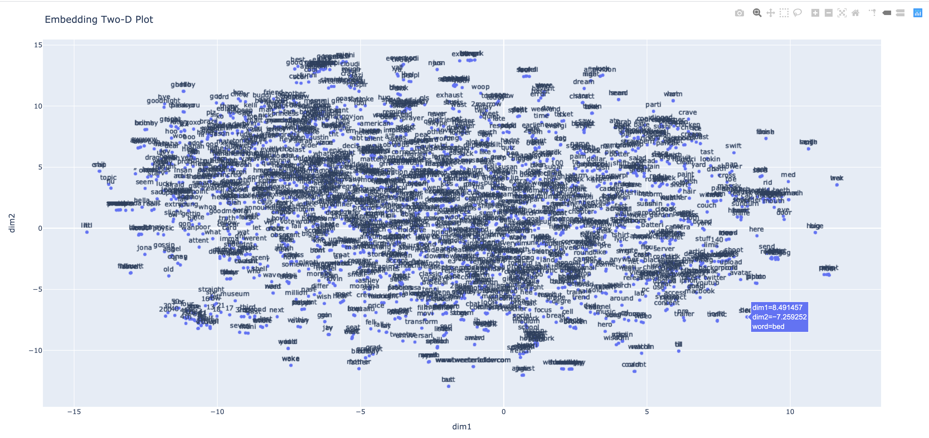
Word Embedding

Slide 12
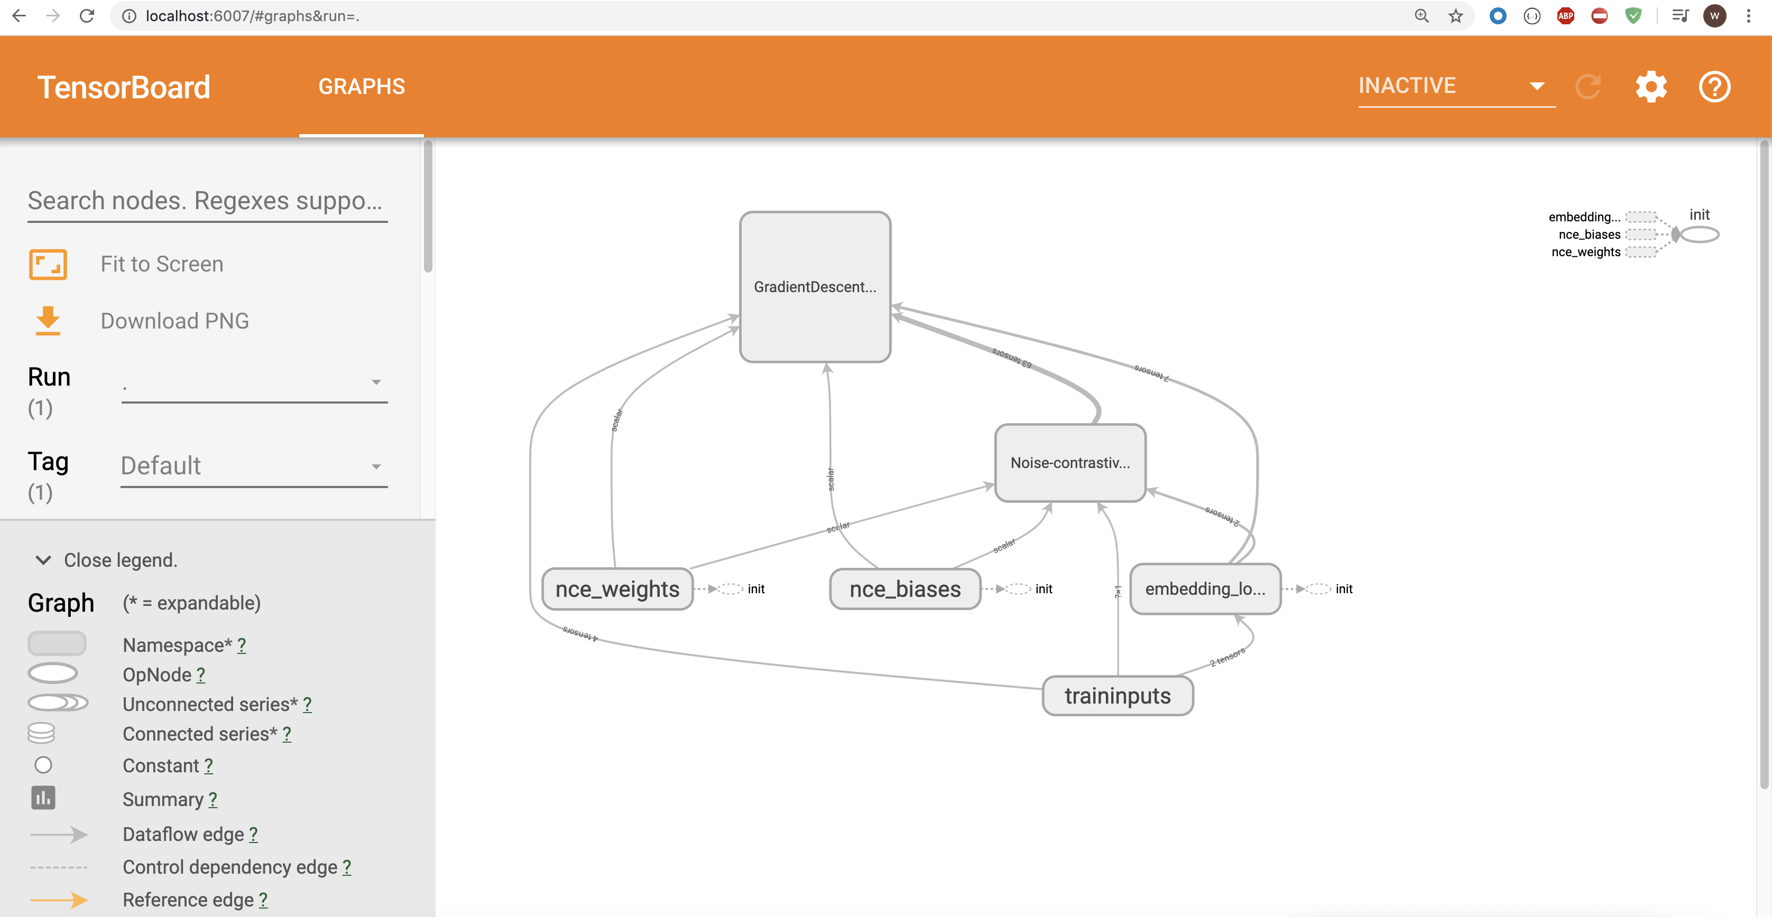
Word Embedding
Noise-contrastiveestimationLoss, Embedding Lookup

Slide 13
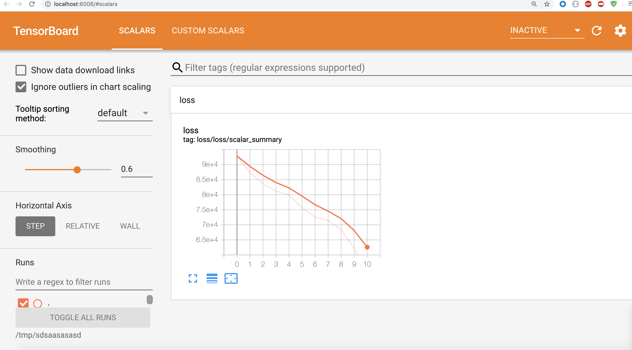
Word Embedding
Noise-contrastiveestimationLoss, Embedding Lookup

Slide 14
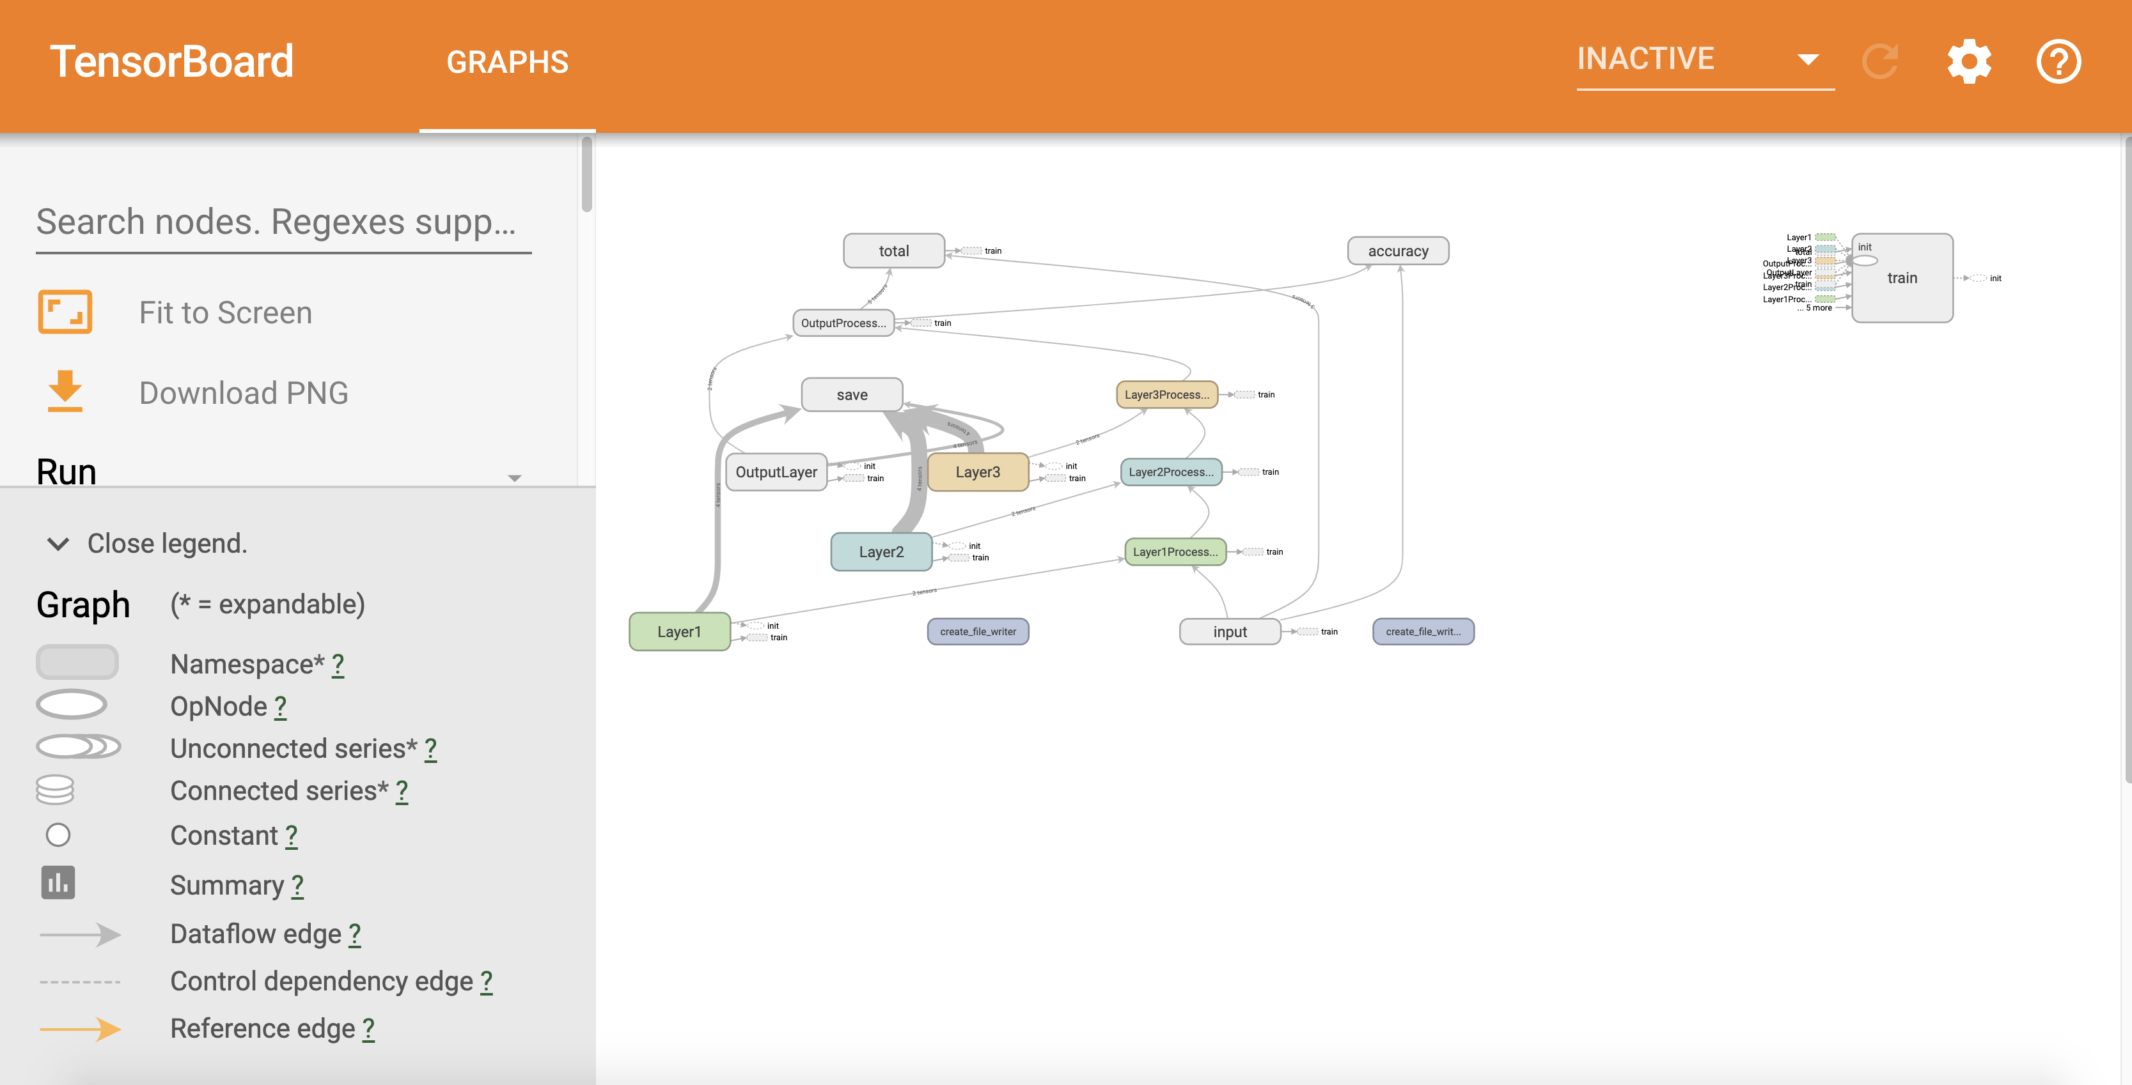
Sentimental Classification
Noise-contrastiveestimationLoss, Embedding Lookup

Slide 15
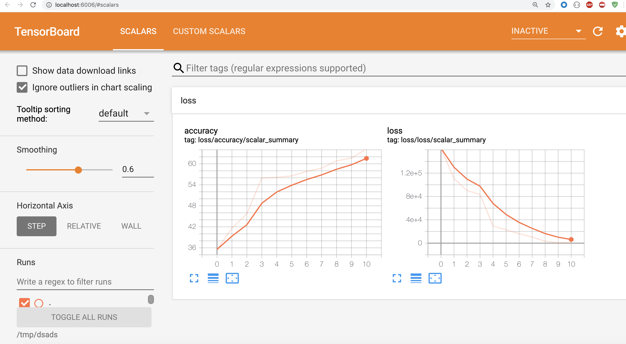
Sentimental Classification
Noise-contrastiveestimationLoss, Embedding Lookup

Slide 16
Sentimental Classification

Slide 17
Predict Sentiment
Given a text, load the word dict model from training:
Count the number of positive words in the text.
Count the number of negative words in the text.
If the number of positive word appearances is greater than the number of negative word appearances return a positive sentiment, conversely, return a negative sentiment.

Slide 18
Output

Slide 19
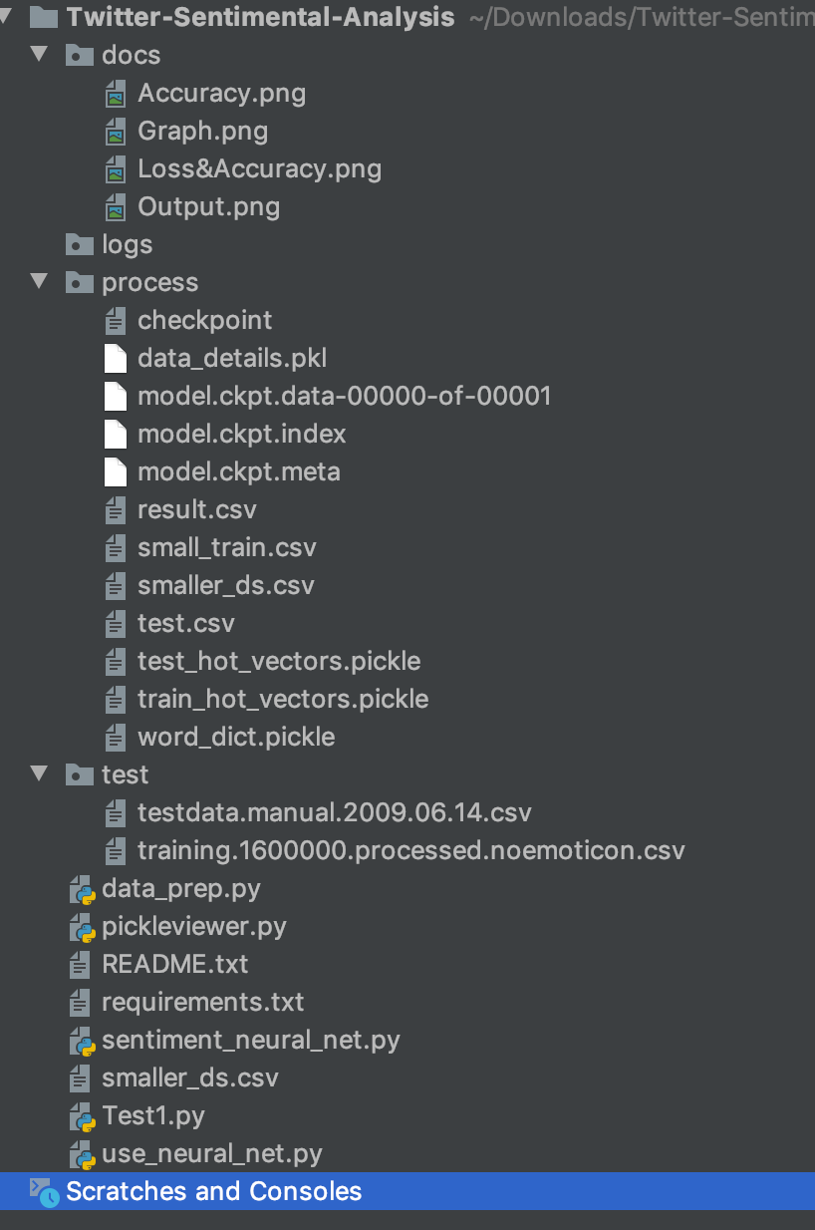
Project Structure

Slide 20
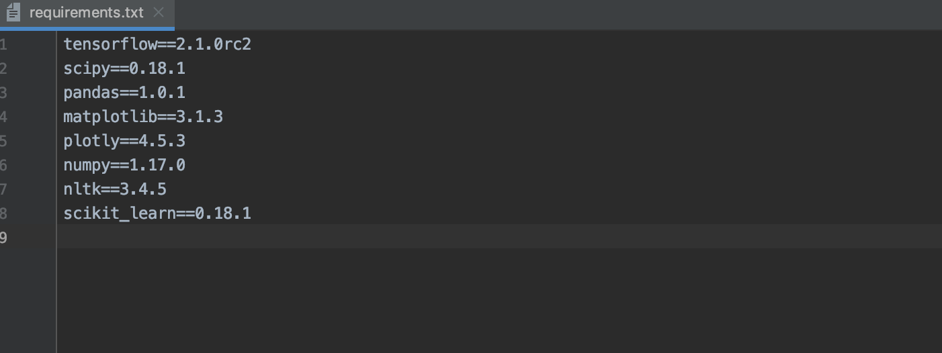
Requirements

Slide 21
Thank You!!!

